Slide 1
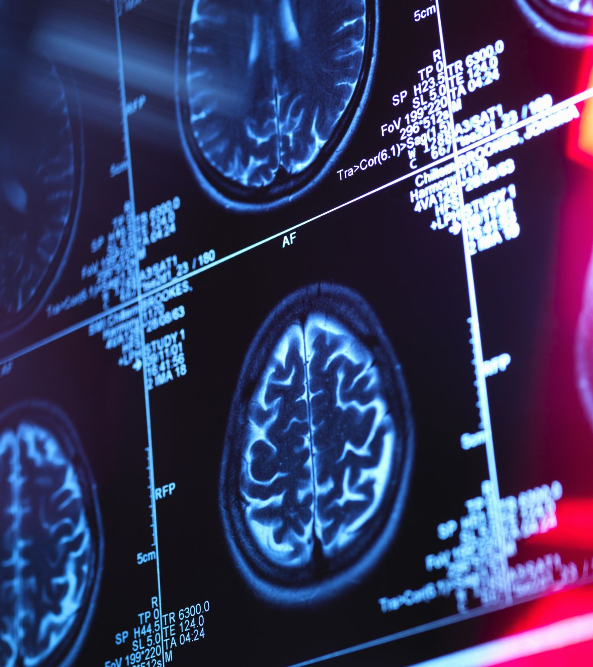
Migraine in 2022
Mark Weatherall
Stoke Mandeville Hospital, UK
May 2022

Slide 2
Lecture structure
Historical background
Neural & vascular theories of migraine
Migraine & CGRP
Migraine pathophysiology
Triptans, gepants, and antibodies
More than a headache
Studies of premonitory phase & aura
Other molecular targets for therapy
The afterlife of the vascular theory
Novel treatment options

Slide 3
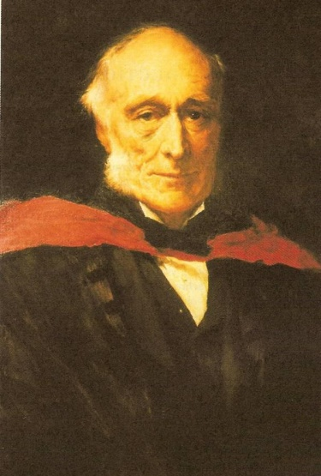
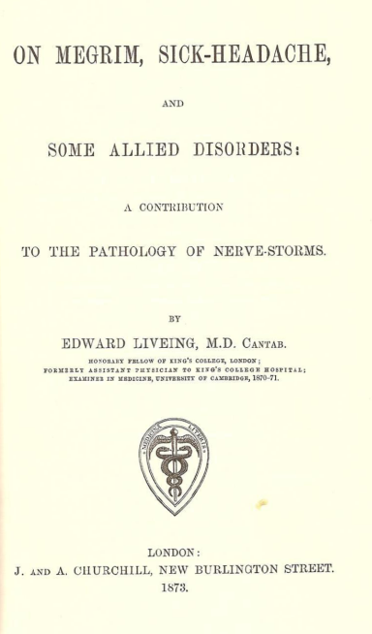
To begin at the beginning… 120 years ago
Edward Liveing’s monograph On Megrim is a classic of clinical description
he develops a theory of migraine as a ‘nerve-storm’ affecting the optic thalamus
crucially this relies upon analogies between migraine and other paroxysmal disorders such as epilepsy, asthma, and tic doloureux – and on contemporary neuroanatomy

Slide 4
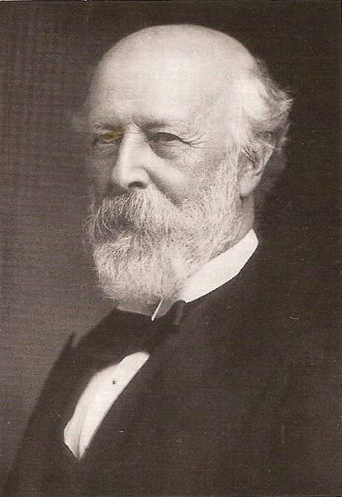
P W Latham’s vascular theory
Latham was a professor of medicine
at Cambridge University
he was a close friend of Liveing
he had been assistant to W W Fisher, an early British pioneer of the sympathetic nervous system
Latham believed that migraine was due to the effects of the sympathetic on the vascular supply to the brain, and was among the first to suggest that vasoconstriction caused aura, while vasodilation caused pain

Slide 5
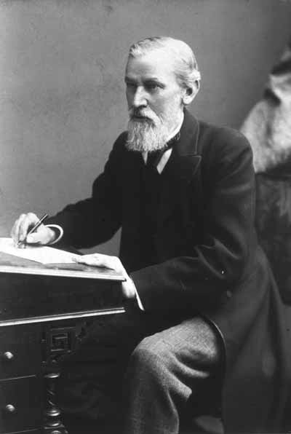
Neural vs vascular
Liveing (and others) criticised Latham’s theory on “the inconsistency of the phenomena”, asking why – if “the contraction of the vessels and the cerebral anæmia are the necessary antecedants of the subsequent hyperæmia and headache” – do many attacks are simply consist of pain, and in others the visual disturbance of aura continues into the headache phase?
similar criticism came from William Gowers in his 1886 Manual of Diseases of the Nervous System

Slide 6
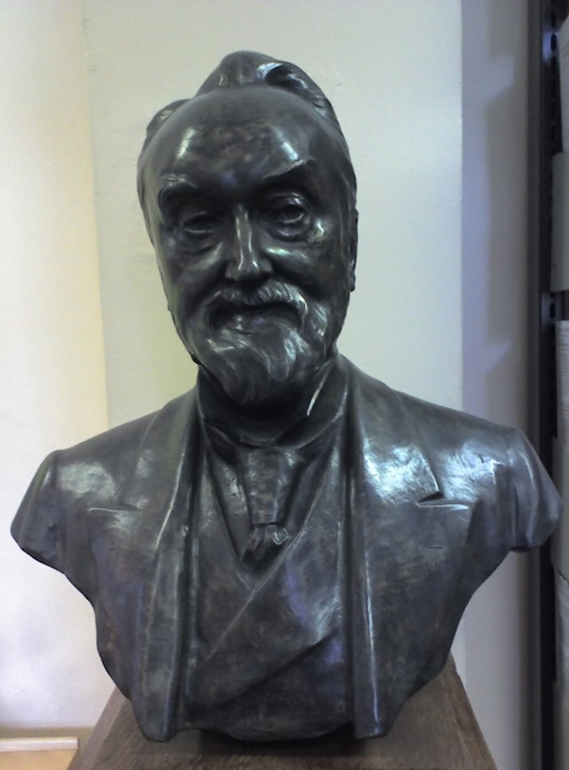
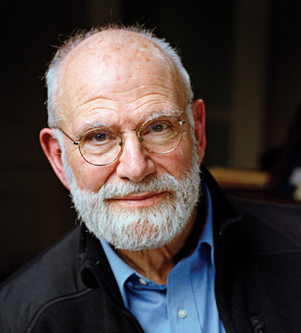
Neural vs vascular
Liveing initially faired better, John Hughlings Jackson supporting the analogy of migraine with epilepsy
it was Gowers who, while an admirer of Liveing’s clinical descriptions (as Oliver Sacks was), demolished the link between epilepsy and migraine in his 1906 lectures on The Borderland of Epilepsy
by the 1920s, therefore, prevailing theories of migraine completely failed to explain the observed phenomena

Slide 7
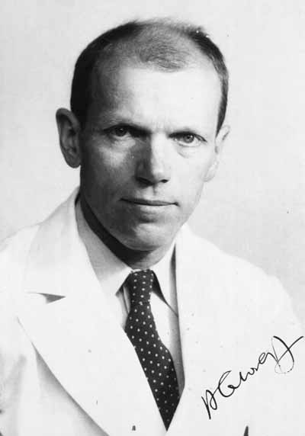
Ergots and migraine
an English physician, Edward Woakes is believed to have been the first to describe the treatment of migraine with ergot of rye in 1878
ergot pharmacology was complex
during WWI, Stoll at Sandoz Pharma isolated ergotamine and showed it to have antimigraine properties, unlike other ergot derivatives
the American physician Harold Wolff studied both the effect of ergotamine on arterial pulsation in migraine attacks

Slide 8
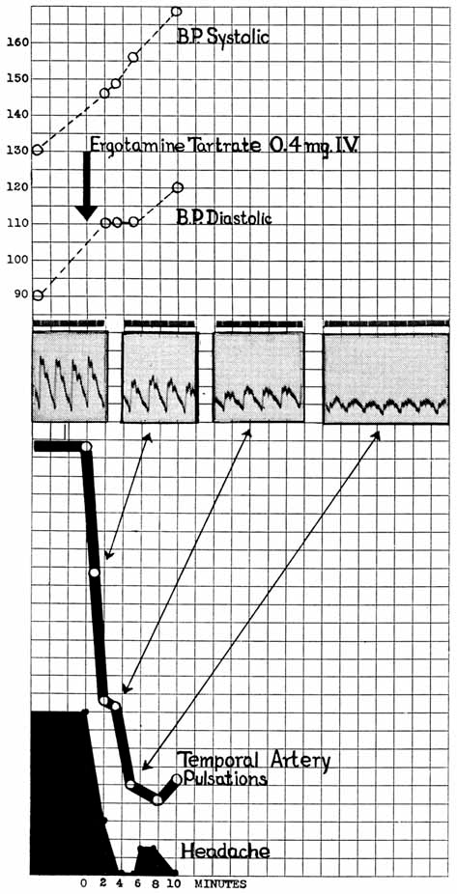
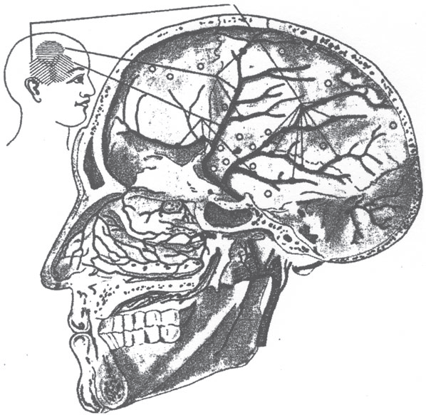
Vascular effects of ergotamine
Wolff and Graham (1938) demonstrated extracranial vasodilation during migraine attacks, and that this was reversed by ergotamine as the attack settled
Ray and Wolff (1940) recorded the localisation of pain following intraoperative stimulation of intracranial structures in volunteers
  this illustration indicates the
  localisation of pain from
  stimulation of the middle
  meningeal artery

Slide 9
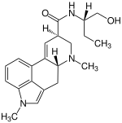
From ergotamine to methysergide
in 1959 the Italian neurologist Federigo Sicuteri published a study demonstrating that 1-methyl-D-lysergic acid butanolamide (methysergide), a more powerful serotonin antagonist than LSD but not a vasodilator, was a safe and effective prophylactic treatment for headache
the first RCT of a migraine treatment was that of methysergide, published in the Lancet in 1964

Slide 10
The legacy of methysergide
in 2008 Neil Raskin recalled the 1960s: “I think back to all those patients that I had sent to psychiatric consultants who came back to me with ‘no psychopathology;’... Suddenly, patients could take a few tablets of methysergide and within a week they were headache-free. No change in their internal milieu. Cured… [T]his drug’s ability to antagonize certain actions of serotonin peripherally abruptly transformed migraine from a psychosocial problem into a scientific one.”

Slide 11
Neural or Vascular? 1986
“The evidence that headache is due to painful vasodilatation of extracranial vessels (especially those supplying the scalp and meninges) remains compelling…”
  intensity of pain ≠ degree of vasodilatation (Wolff had shown this in 1950s)
  what other factor/s contributed to the sterile inflammatory process around these vessels?
  candidates included serotonin, VIP, substance P
“The current lack of clinical antagonists of other putative neurotransmitters… hampers further developments along these lines.”

Slide 12
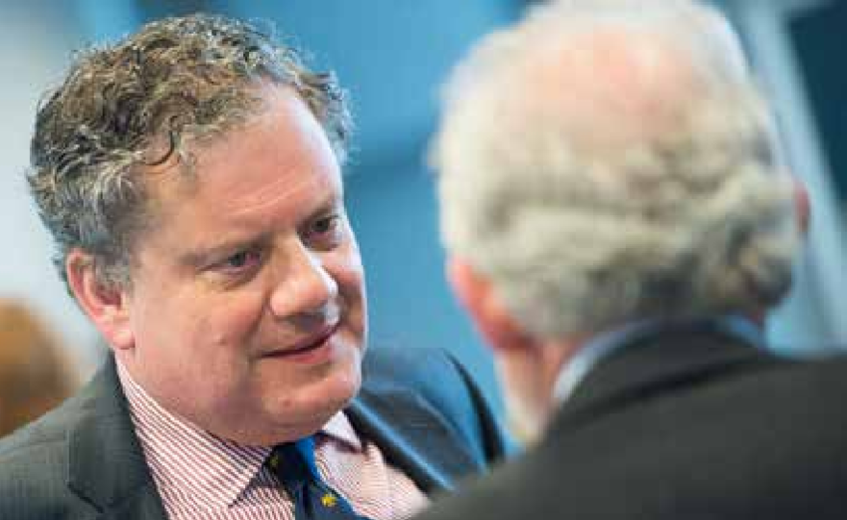

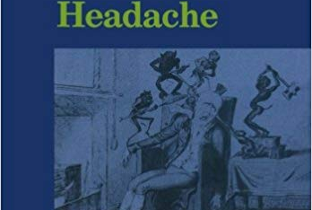
Neural or Vascular? 1986
“Peptides remain attractive as they act for longer than the smaller neurotransmitters, and their ready depletion at high rates of stimulation goes some way to explaining the separation of attacks and the refractory periods to the patient’s usual triggering factor immediately after each attack.”

Slide 13

Migraine as a
CGRP disease

Slide 14
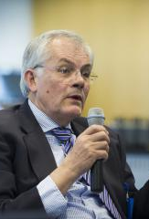
From ergots to triptans
studies of methysergide in the 1960s and 1970s indicated the importance of a whole family of serotonin receptors in migraine pathogenesis
in the early 1980s Patrick Humphrey of Glaxo developed a series of serotonin subtype agonists, one of which (GR43175) proved to have excellent antimigraine properties; this was eventually marketed as Imigran (sumatriptan)
Humphrey used the dog saphenous vein as a model to test candidate molecules

Slide 15
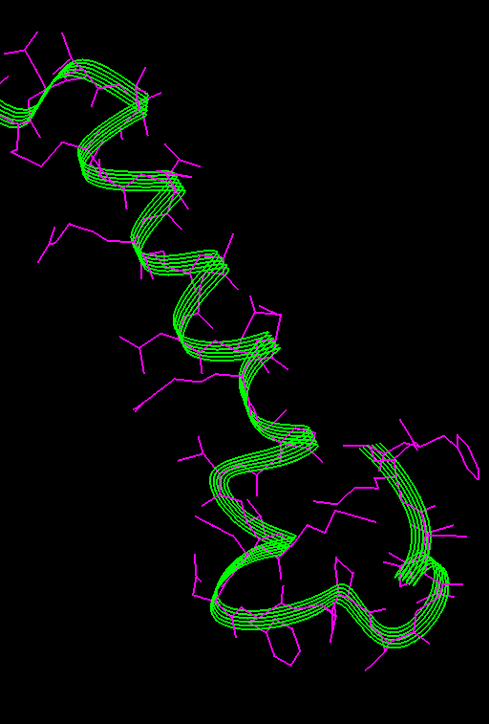
CGRP
in the early 1990s studies by Peter Goadsby and Lars Edvinsson, amongst others, demonstrated a central role for calcitonin-gene related peptide (CGRP) in migraine pathophysiology
CGRP produced by primary afferent neurons of the trigeminal ganglion
CGRP levels elevated in jugular venous blood & saliva during attacks
venous CGRP levels elevated in migraine patients between attacks

Slide 16
CGRP
CGRP infusion induces migraines
treatment of migraine with triptans reduces CGRP levels as pain falls
this was not true of other candidates vasoactive molecules such as VIP and substance P
action of triptans was shown to be due to the blocking of release of CGRP, mediated through the activation of 5-HT_{1B/1D} receptors

Slide 17
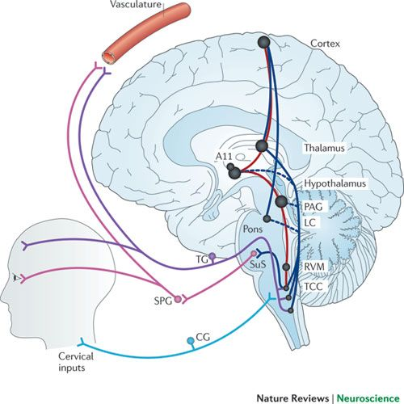
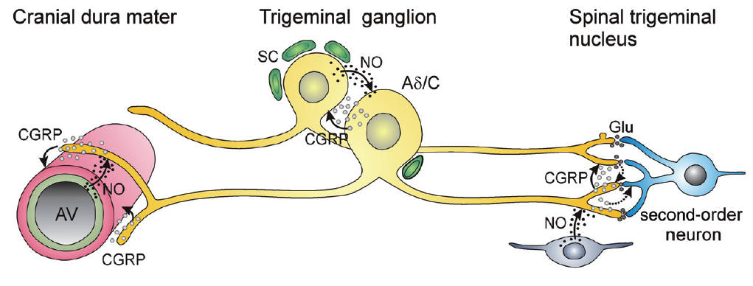
CGRP: potential sites of action

Slide 18
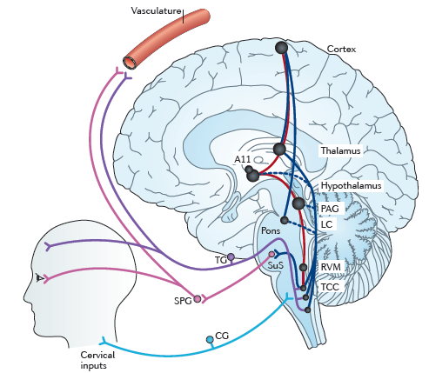
Migraine physiology
activation of the trigeminocervical complex leads to neurogenic plasma extravasation, mast cell degranulation, platelet aggregation around dural & meningeal blood vessels via release of substance P, CGRP, and VIP, but not all of these are relevant for migraine
pain signals feedback along this loop to the trigeminal nucleus caudalis
extracranial vasodilation is an epiphenomenon

Slide 19
Migraine physiology
dysfunctional descending modulatory pathways fail to damp down the increased activity in the TCC/SPG/vascular/TG loop
ascending pathways connecting the TCC, brainstem nuclei, hypothalamus, thalamic and cortical structures become activated, and are all involved in pain processing in migraine

Slide 20
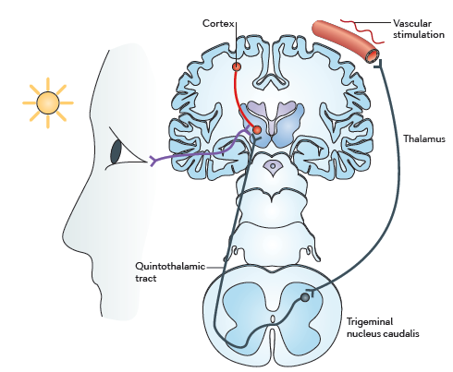
Migraine physiology
thalamic nuclei recieve input from TCC and provide output to cortex (somatosensory, visual, associative)
they also receive direct input from axons originating in retinal ganglion cells, which may be the basis of photophobia

Slide 21
Sensory processing in migraine
electrophysiological studies of stimulus-evoked brain activation indicate that sensory processing in migraine patients is abnormal between attacks
  the main findings are increased amplitudes and decreased habituation of cortical evoked potentials for every stimulation modality including nociceptive stimuli
2/3 migraine patients experience allodynia during attacks, including ipsilateral & contralateral ULs
  consistent with third-order neuronal (thalamic) involvement, probably a form of dysinhibitory sensitization due to dysfunctional descending modulatory pathways

Slide 22
Targets other than CGRP proved ineffective
potential migraine drugs that were effective in migraine models, but failed in clinical proof-of-concept trials include:
  plasma protein extravasation blockers CP 122.288; 4991W93
  substance P antagonist GR 205171
  5-HT_{1D} agonist PNU 142633
  TRPV1 antagonist SB 705498

Slide 23
Limitations of triptans
triptans may be ineffective because of inadequate dosing, being taken too late in the attack, or poor absorption (gastroparesis or vomiting)
patients may respond to a second or third triptan if they do not respond to a first or second one but even under ideal circumstances (sc) ~10% do not respond
triptans are relatively contraindicated in patients with cardiac or cerebrovascular disease and uncontrolled hypertension
triptan response may have implications for understanding migraine physiology
poor responders exhibit fewer premonitory symptoms
migraineurs with unilateral cranial autonomic symptoms may respond better to triptans

Slide 24
CGRP antagonists
BIBN4096BS: a specific & potent CRGP receptor antagonist
safety & tolerability studies showed well tolerated
it did not affect cerebral or systemic haemodynamics in healthy volunteers
animal studies showed dose-dependent inhibition of activity in the trigeminocervical complex evoked by electrical stimulation of the superior sagittal sinus; the maximal effect was seen within 30 min of administration

Slide 25
CGRP antagonists
international multicentre DBRPC ‘proof-of-concept’ trial published in NEJM in 2004
  126 patients 18-65, 1-6 migraine/month, all white) treated with placebo or BIBN4096BS
  doses between 0.25 mg & 10 mg IV used
BIBN4096BS was christened olcagepant

Slide 26
Was the future to be ‘pants’?
phase II study of oral CGRP antagonist MK-0974 (subsequently telcagepant) presented at IHS 2007 and published in Neurology in 2008
multicentre phase III RPCDBT of oral telcagepant 150 or 300 mg vs zolmitriptan 5 mg and placebo was published in The Lancet in December 2008

Slide 27
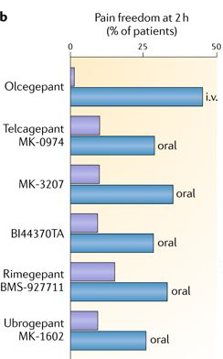
Pants are dead... long live gepants?
olcegepant and telcegepant are dead, the latter killed in Phase IV studies where it was shown to cause significant derangement of liver function in a small number of users
another CGRP antagonist MK-3207 was also dropped because of concerns re hepatotoxicity
however, three other gepants have made it through Phase II trials – MK-1602 (ubrogepant), BMS-927711 (rimegepant), and BI 44370
Allergan have recently trialled AGN-241689 (atogepant) as a preventive therapy

Slide 28
CGRP antibodies
while CGRP antagonist development was proceeding, other approaches to CGRP blockade were being considered
  first patent for use of CGRP antibody to treat migraine was filed in 2005
first clinical trials were initiated in 2011
between 2014-16 four mAbs were shown to be effective in Phase II trials
  phase III trials have been published in 2017 & 2018 for three mAbs so far
FDA approval was granted for erenumab (Aimovig) in June 2018
  two further mAbs have been approved in the USA, one so far in Europe

Slide 29
CGRP antibodies

Slide 30
Phase II studies – episodic migraine
Galcanezumab
Eptinezumab
Fremanezumab
Erenumab

Slide 31
CGRP antibodies – chronic migraine
Smith J et al, Headache 2017;57:130
Tepper S, et al Lancet Neurol. 2017;16(6):425-34.
Silberstein SD, et al N Engl J Med. 2017;377(22):2113-22.
Detke HC et al, Headache 2017;57:1336-7
Aurora SK, et al Headache. 2011;51(9):1358-73.
Silberstein SD, et al Headache. 2007;47(2):170-80.
I am grateful to Dr Manjit Matharu for this slide.

Slide 32
CGRP antibodies – safety & side effects
safety: no changes in
  blood pressure/heart rate
  ECG
    no findings in efficacy studies
    no change in treadmill test with erenumab 140 mg IV
  laboratory tests – specifically no liver function abnormalities
adverse events
  injection site reactions
  nasopharyngeal/URTIs - constipation
anti-drug antibodies
  reported but no evidence that they are deleterious – yet

Slide 33
Long term concerns with CGRP antibodies?

Slide 34

Migraine – more than just CGRP?

Slide 35
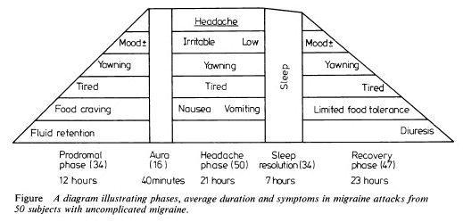
Migraine: more than ‘just a headache’

Slide 36
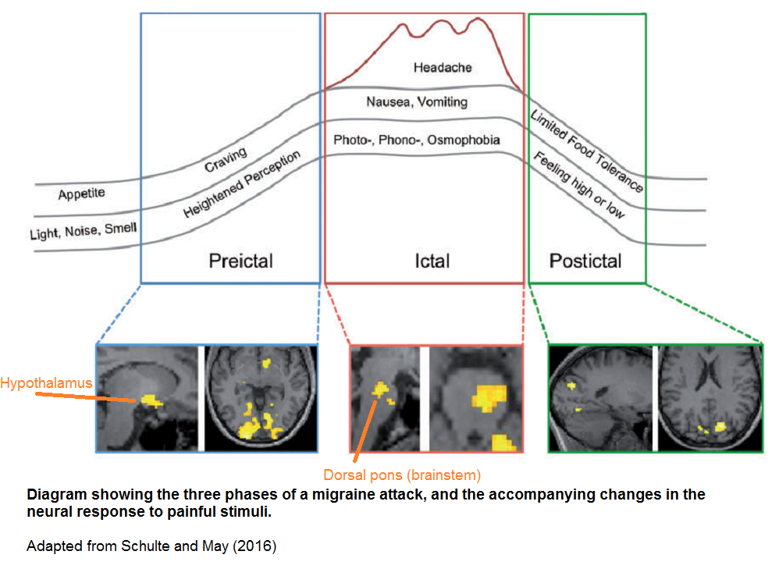
Blau 2.0 (Schulte & May, 2016)

Slide 37
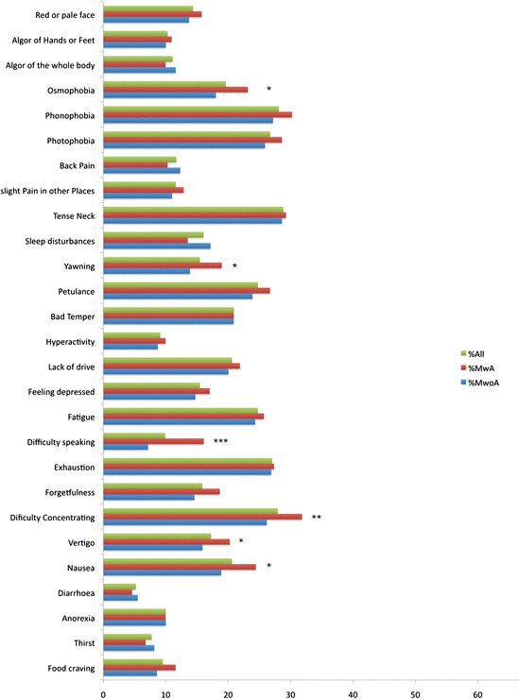
The premonitory phase
can occur in ~20% patients
often 12-24 hrs prior to aura or headache – can be longer
many characteristic symptoms are mediated through dopamine
isolated studies from 1980s suggest treating with domperidone at this stage may abort or ameliorate attacks

Slide 38

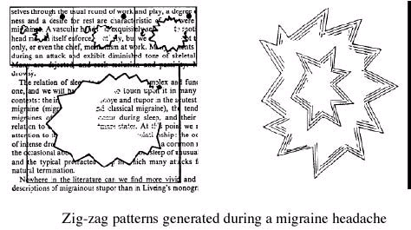
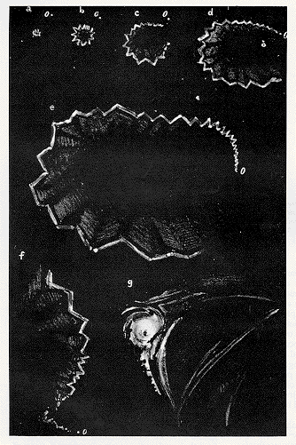
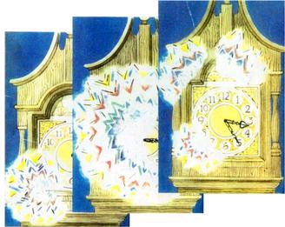
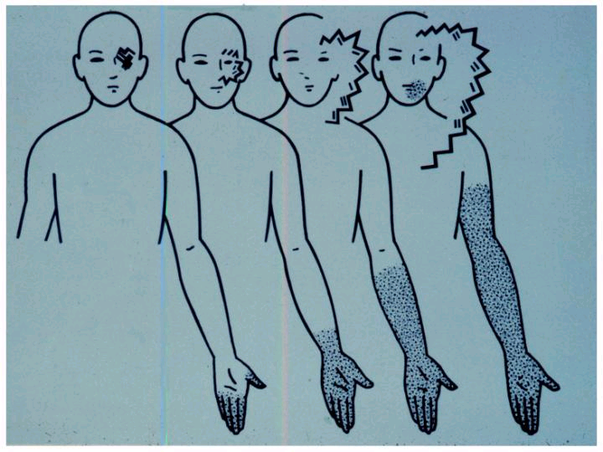
Aura

Slide 39
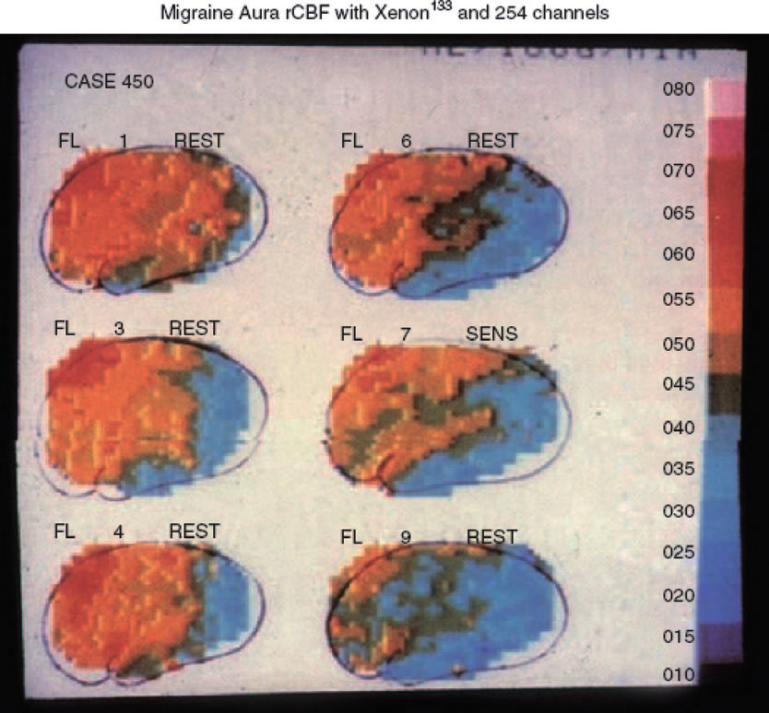
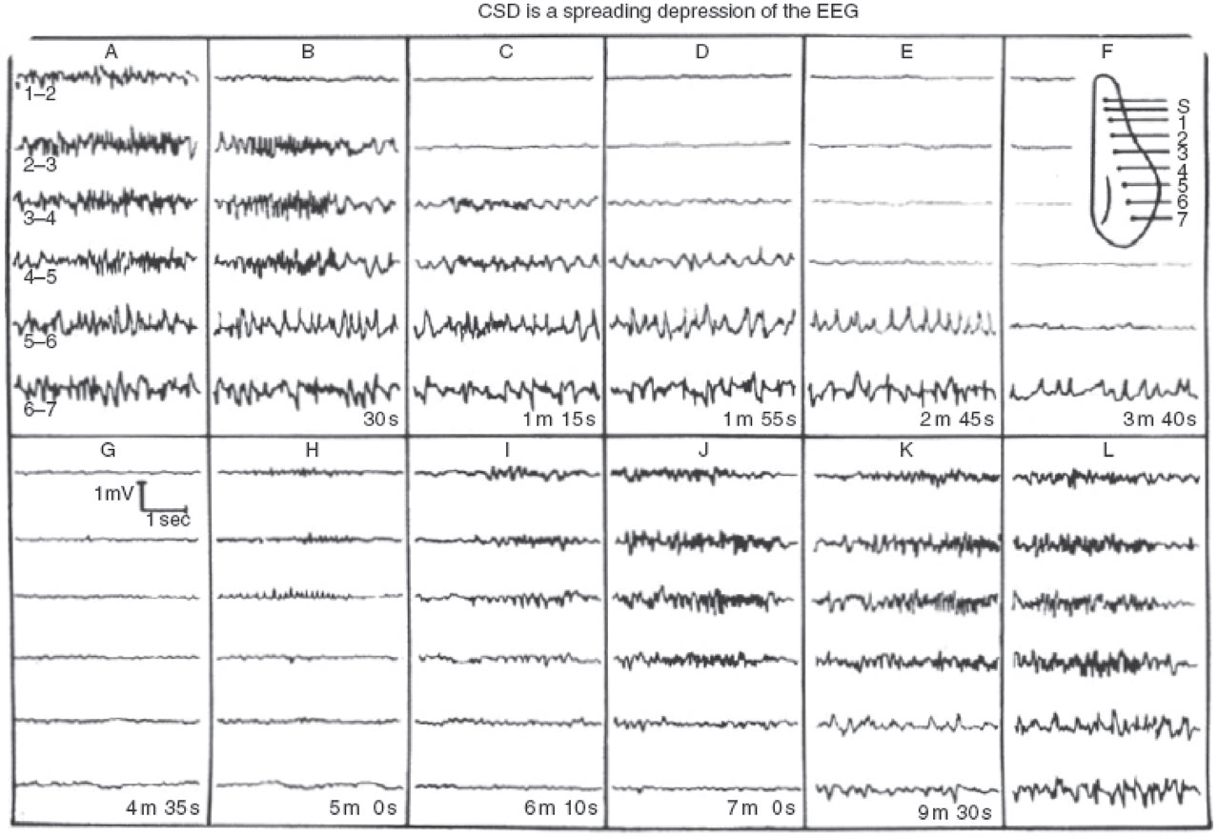
Cortical spreading depression

Slide 40
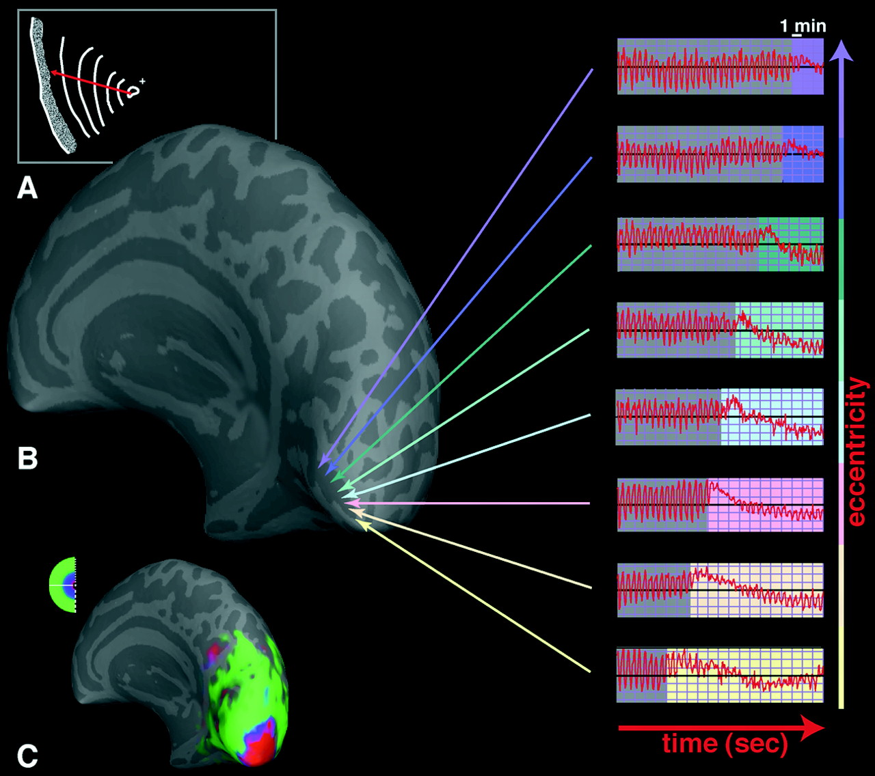
Cortical spreading depression
(A) A drawing showing the progression over 20 min of the scintillations and the visual field defect affecting the left hemifield, as described by the patient
(B) MR signals recorded in the primary visual cortex (V1), from the posterior pole to more anterior location. A similar BOLD response was found in all areas, differing only in the time of onset of the MR perturbation. The MR perturbations developed earlier in the foveal representation, compared with more eccentric representations of retinotopic visual cortex. This finding was consistent with the progression of the aura from central to peripheral eccentricities in the corresponding visual field (A and C).
(C) MR maps of retinotopic eccentricity from this same subject, acquired during interictal scans. Voxels that show retinotopically specific activation in the fovea are coded in red, parafoveal eccentricities in blue, and more peripheral eccentricities in green

Slide 41
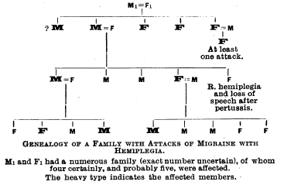
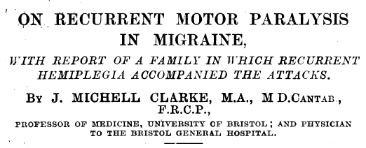
From classical genetics…
the familial nature of migraine has been known to commentators since ancient times
the first probable case of familial hemiplegic migraine was published in the BMJ in 1910

Slide 42
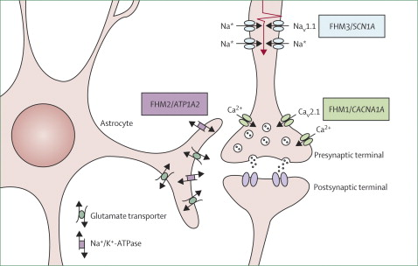
… to familial hemiplegic migraine genes, to…
4 FHM genes have been identified, the first in 1996 – 3 encode ion channels active around glutaminergic synapses, resulting in increased Glu release, post-synaptic Glu uptake, or neuronal firing rate, respectively
  19p13: CACNA1A (FHM 1)
  1q23: ATP1A2 (FHM 2)
  2q24: SNC1A (FHM 3)

Slide 43
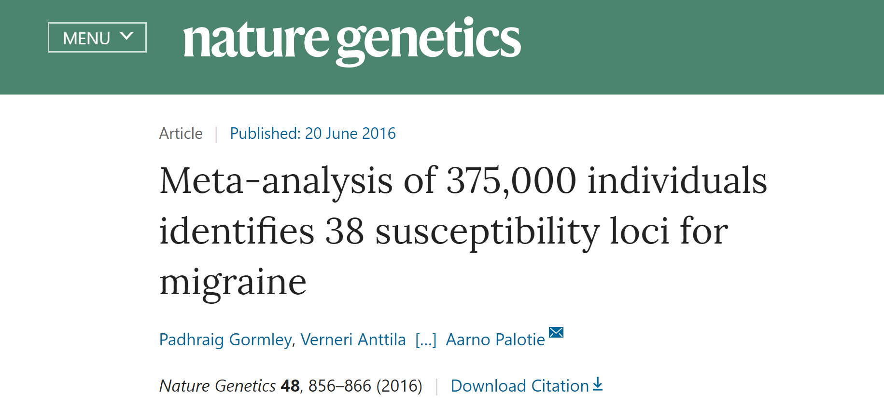
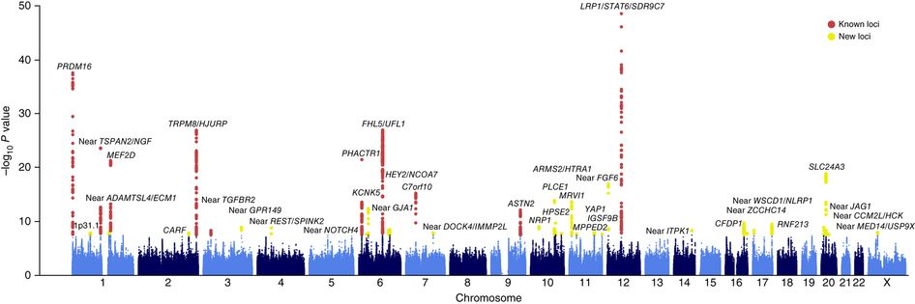
… migraine genomics

Slide 44
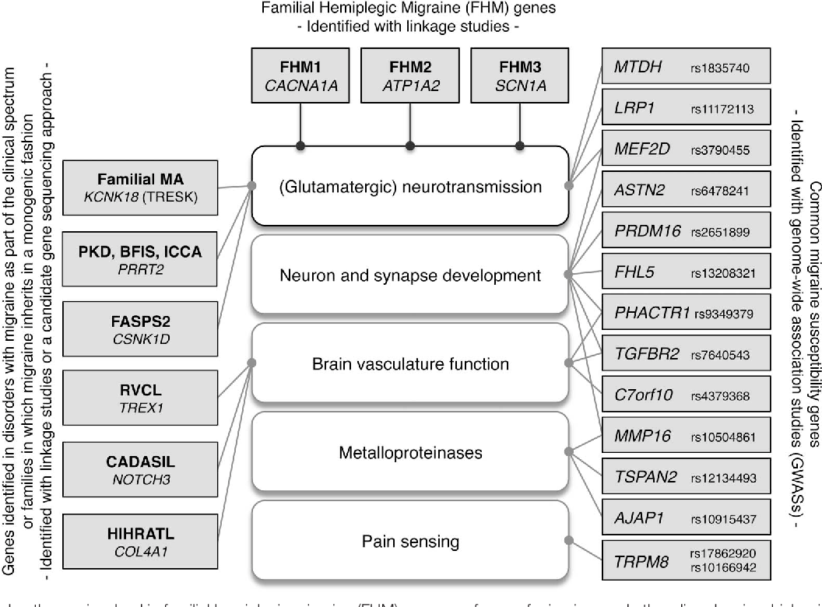
What do ‘migraine genes’ do?

Slide 45
The vascular hypothesis: dead but not gone
migraine with aura is a characteristic feature of a number of genetic or acquired vasculopathies
  CADASIL, mitochondrial disorders, ?APLS
migraine with aura is a small but independent risk factor for CVA in women aged 21-45
  greatly increased by smoking +/- COCP
case studies of migraine with aura induced by vascular or cardiac surgery
the controversial PFO saga

Slide 46
Migraine 2012-2022
ICHD 3 beta 2013, with 3rd edition finalised 2018
high quality epidemiological studies (AMPP & CaMEO in USA; HUNT study in Norway; MRI CAMERA study in Netherlands)
  multiple country-based studies run by the Lifting The Burden campaign
more studies of migraine and vascular risk
  migraine included in QRISK3 in 2018
more studies of migraine genetics & genomics
  e.g. potassium channel TRESK gene linked to familial MA 2010

Slide 47
Future directions: other systems
descending antinociceptive systems may be predominantly dopaminergic and orexinergic
there is a growing evidence base for the role of the hypothalamus in the pathophysiology of migraine
  manipulation of orexinergic processing produces differential effects on trigeminal mediated pain
  orexin A is anti-nociceptive, while orexin B is either ineffective or pro-nociceptive dependent on the route of administration
population genetic studies implicate genes that are involved with glutamate signalling in migraine, and gene mutations responsible for familial hemiplegic migraine and other familial migraine syndromes may influence glutamate signalling

Slide 48
Other systems involved in migraine
pituitary adenylate cyclase-activating polypeptide (PACAP) is expressed in the trigeminovascular system and has been implicated in migraine pathophysiology
  infusing PACAP triggers migraine-like headaches in human subjects
targeting 5-HT_{1F} receptors on neurons in the central and peripheral trigeminal system, decreases neuropeptide release and inhibits pain pathways, including the trigeminal nerve
  5-HT_{1F} receptors are highly expressed in human middle cerebral arteries and human coronary arteries, but in vitro studies suggest that 5-HT_{1F} receptors do not mediate significant vasoconstriction effects in these vessels

Slide 49
Emerging non-CGRP targeted therapies
lasmitidan is a 5-HT_{1F} agonist
pain freedom at 2 hours:
  lasmiditan 200 mg: SAMURAI 32.2%, SPARTAN 38.8%
  placebo: SAMURAI 15.3%, SPARTAN 21.3%
significance was also noted for other lasmiditan dose groups (100 mg, 50 mg) compared to placebo
most frequently reported AEs with lasmiditan (≥2% and >placebo) were dizziness, paresthesia, somnolence, fatigue, nausea, lethargy
lasmitidan was approved by the FDA on 11/10/2019

Slide 50
Glutamate: ADX10059
metabotropic glutamate (mGlu) receptors are established modulators of inflammatory and neuropathic pain circuits in the spinal cord and brainstem
ADX10059 is a potent and selective negative allosteric modulator of the mGlu₅ receptor that does not have significant activity or binding affinity to other mGlu receptors, or other central nervous system (CNS) receptors, in particular, serotonin, dopamine, and γ‐aminobutyric acid (GABA) receptors
greater proportion of patients who treated their initial moderate to severe headache pain with ADX10059 375 mg (10/60, 17%) became pain free at 2 h compared to placebo (3/64, 5%)
AE: 48% dizziness, nausea 21%, vertigo, vomiting, blurred vision ≥10%

Slide 51
Orexins, PACAP, endocannabinoids
unfortunately a single clinical trial (of the orexin receptor antagonist filorexant) failed to show any effect in migraine prophylaxis
the PAC1 receptor has been identified as a receptor which binds the PACAP molecule with high affinity
  AMG 301, is a PAC1 receptor selective antagonist is in Phase II studies
  in preclinical studies, AMG 301 has shown responses comparable to those observed with triptans
the endocannabinoid anandamide is metabolised by FAAH (fatty acid amide hydroxylase) – FAAH levels may be higher in migraine patients
  early POC studies of FAAH inhibitors for prevention show promise

Slide 52
Migraine Treatment

Slide 53
How well do analgesics work?

Slide 54
Preventive treatments 1965-2005
tricyclic antidepressants (amitriptyline (1969))
anti-hypertensives (beta-blockers e.g. propranolol or atenolol (1970s)/candesartan (2003)/lisinopril (2001)/clonidine (1969))
serotonin antagonists (methysergide (1964)/cyproheptadine (1963)/pizotifen (1967-71))
calcium channel blockers (flunarizine (1981-84)/verapamil)
anticonvulsants (topiramate (2001)/sodium valproate (1992)/gabapentin)
  specific mechanisms of action remain largely unknown

Slide 55
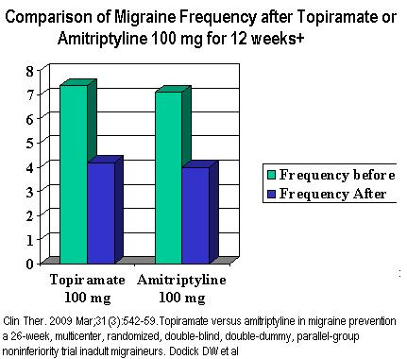
Amitriptyline
1979 small DBRCT AMI 25 mg: responders 55% vs 34% placebo
since then a number of comparison/non-inferiority trials incl propranolol and topiramate
traditional first line Rx at 10-25 mg, rising to 75-150 mg
SE: fatigue, dry eyes, dry mouth, constipation
  other tricyclics may be better tolerated

Slide 56
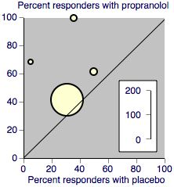
β-blockers
all without partial agonist properties work for migraine
overall responder rate: 53% compared with 31% with placebo
SE in 10-15%
  Fatigue (decreased exercise tolerance); dizziness; insomnia; depression; decreased libido
CI: asthma, COPD, Raynaud’s, PVD

Slide 57
Candesartan
2003 Norwegian DBPC crossover trial (n=57) with candesartan 16 mg
  over 12/52, the mean number of HA days 18.5 with placebo vs 13.6 with candesartan
  candesartan responders (reduction of > or =50% compared with placebo) was 23 (40.4%) for days with migraine
in a 2013 trial by same group candesartan was non-inferior to propranolol
  the proportion of responders was significantly higher on candesartan (43%) and propranolol (40%) than on placebo (23%)
generally well tolerated at 4-16 mg, dizziness being most common SE

Slide 58
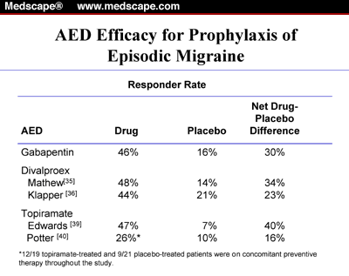
Anticonvulsants
Negative trials exist for LAMOTRIGINE, OXCARBAZEPINE, VIGABATRIN
Very poor quality studies exist for CARBAMAZEPINE, CLONAZEPAM
Open label trials show promise for PREGABALIN, TIAGABINE
Small RCT/non-inferiority trials support use of ZONISAMIDE, LEVETIRACETAM

Slide 59
Topiramate
landmark trials
  MIGR-001: Silberstein et al, 2004: at 100 mg daily 54% responder vs 23% placebo
  MIGR-002: Brandes et al, 2004: 49% vs 23%
  Diener et al, 2004: 37% vs 23% vs 43% propranolol 160 mg
usual regime starts at 12.5-25 mg nocte, increasing in 25 mg steps to 50 mg bd
higher doses can be used if benefit modest and drug well-tolerated

Slide 60

Topiramate
SE common:
  Parasthesiae
  Fatigue
  Tremor
  weight loss
  visual disturbances (incl. glaucoma)
  kidney stones
  cognitive problems (word-finding difficulties, agitation, confusion, depression, psychosis)

Slide 61
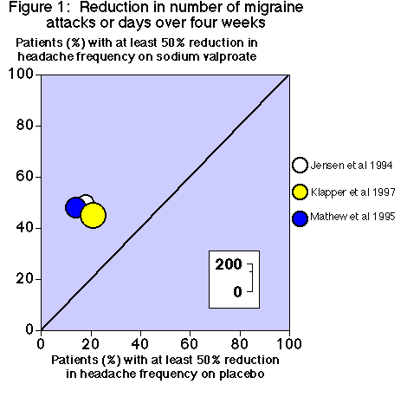
Sodium valproate
CI: (risk of) pregnancy, ↓ platelets
SE: fatigue, nausea, tremor, weight gain, hair loss, liver & pancreatic dysfunction
typical regime: 200 mg daily, increasing in 200 mg steps to 800-1000 mg daily

Slide 62
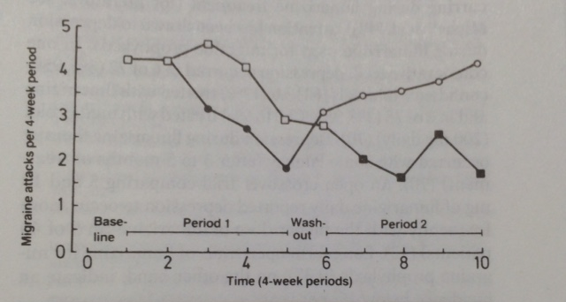
Flunarizine
calcium channel blocker 5-10 mg daily
? drug of choice for severe aura, hemiplegic migraine, migrainous vertigo
  t½ = 18 days
  SE: fatigue, constipation, depression, extrapyramidal signs
licensed in UK but not widely used
  available on a ‘named patient’ basis

Slide 63
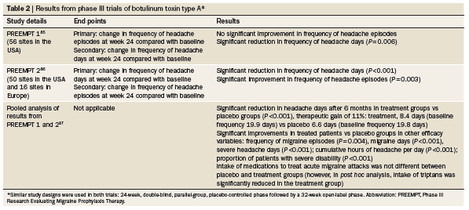
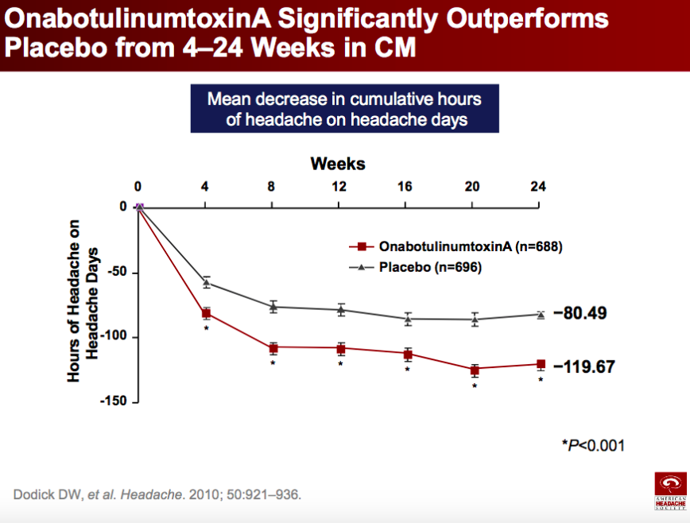
Botox

Slide 64
Occipital nerve blockade
widely used technique with a number of published case series
published DBRCTs show divergent results:
  2.5 mL 0.5% bupivacaine plus 0.5 mL (20 mg) methylprednisolone over the ipsilateral (unilateral headache) or bilateral (bilateral headache) ON; vs 2.75 ml normal saline plus 0.25 mL 1% lidocaine (placebo) - 50% reduction in the frequency of moderate or severe headache days was 30% for both groups (10/30 vs 9/30, Δ 0.00, 95% CI -0.22 to 0.23) over 4 weeks
  2 mL 0.5% bupivacaine vs saline – 50 % reduction in the frequency of moderate or severe headache days was 55.6% vs. 27.8%; OR 3.25, 95% CI 1.36–7.78, p = 0.008 over 1 week

Slide 65
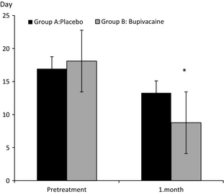
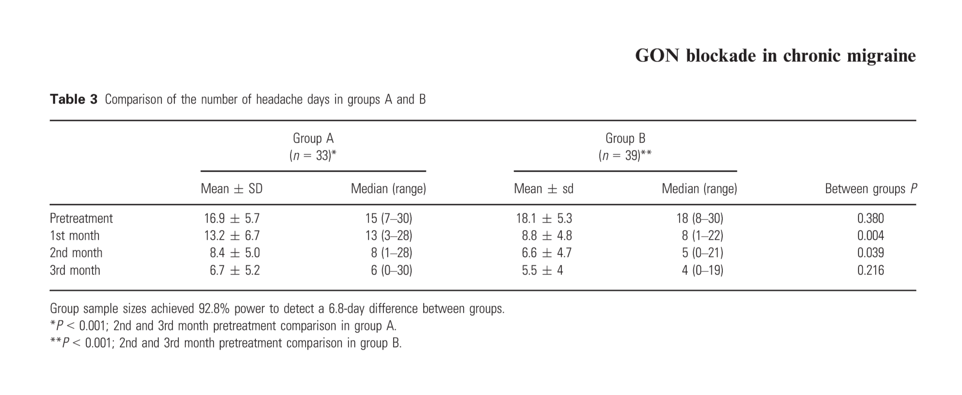
Occipital nerve blockade
1.5 mL 2% bupivacaine vs saline, given weekly for 4 weeks

Slide 66
CGRP antibodies – chronic migraine
Smith J et al, Headache 2017;57:130
Tepper S, et al Lancet Neurol. 2017;16(6):425-34.
Silberstein SD, et al N Engl J Med. 2017;377(22):2113-22.
Detke HC et al, Headache 2017;57:1336-7
Aurora SK, et al Headache. 2011;51(9):1358-73.
Silberstein SD, et al Headache. 2007;47(2):170-80.
I am grateful to Dr Manjit Matharu for this slide.

Slide 67
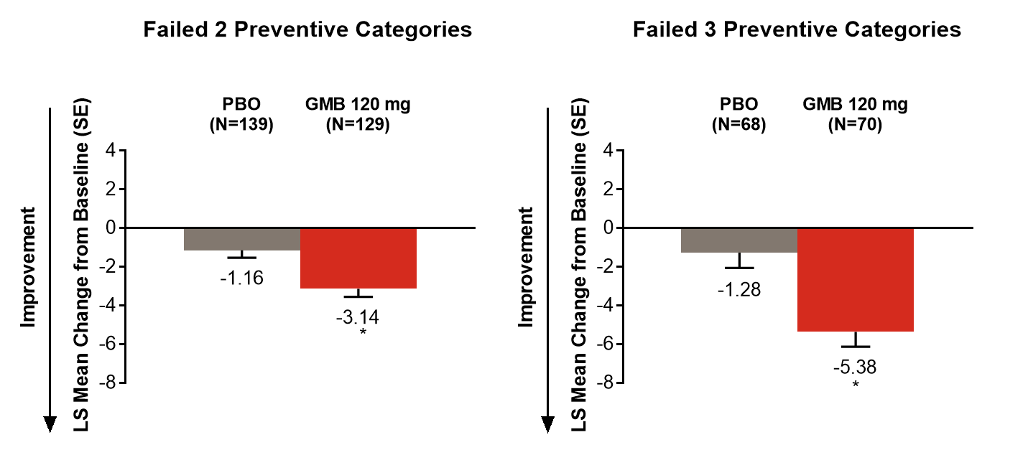
Galcanezumab CONQUER Study

Slide 68
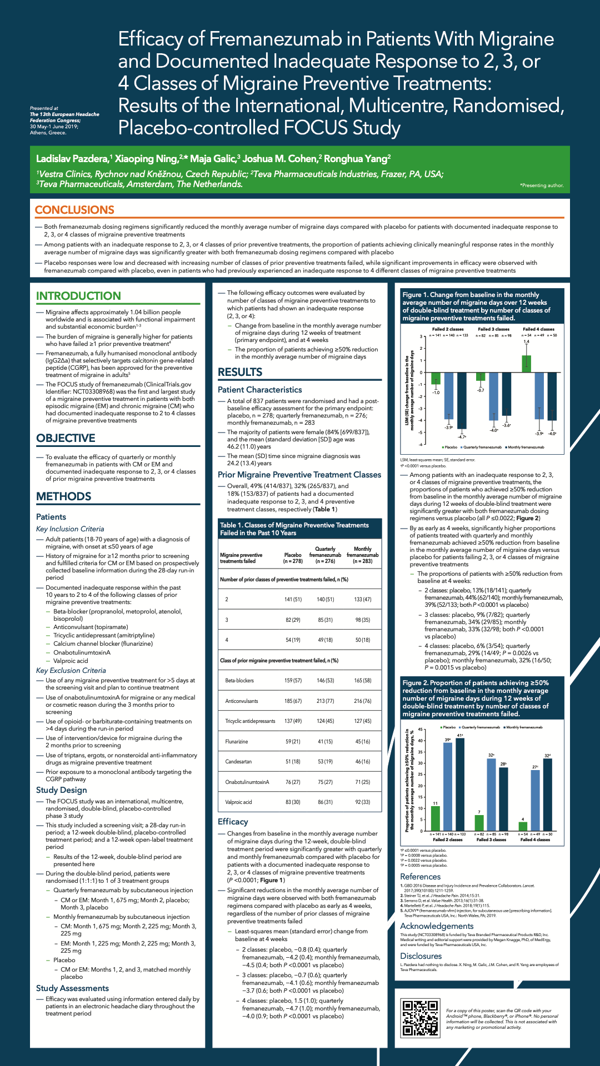
Fremanezumab FOCUS Study
Prior Botox failures

Slide 69
Transcranial magnetic stimulation
TMS is a non-invasive technique that applies a brief magnetic pulse to the scalp and underlying cortex, changing the pattern of neuronal firing
developed in the 1980s
  used for anatomical brain imaging
  other therapeutic purposes, esp depression
  In migraine used to demonstrate abnormal cortical excitability (by eliciting phosphenes following occipital lobe stimulation)
initial studies in migraine with aura
  The hypothesis being that TMS would disrupt CSD, the pathophysiological substrate of aura

Slide 70
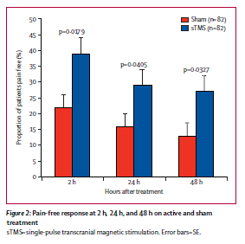
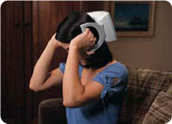
Landmark TMS trial
double blind, parallel group, sham controlled trial published in Lancet Neurology in 2010 in patients with aura
acute treatment with 2 pulses at 30 sec intervals within hour of aura onset
39% pain free at 2 hr vs 22% sham
  Sustained pain free rates at 24/48 hr in favour of TMS
    global assessment of relief better in sham arm
    no difference in medication use
    safe and well tolerated
CE mark, 2011
NICE IPG 477, 2014

Slide 71
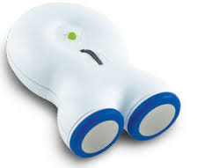
Vagus nerve stimulation
interest originated from a case report (2002) in which a patient who had VNS implanted to treat epilepsy reported cessation of headaches after 8/52
Alex Mauskop in NY treated 4 patients with refractory migraine, two of whom improved significantly
with creation of a non-invasive VNS device, trials in primary headache disorders have become possible

Slide 72

Why the vagus?
PJG: “The vagus nerve is a remarkable nerve by any standards, and would even fascinate other organ-based specialists as it innervates important structures very broadly.”
mixed sensory and motor nerve that serves several major organs including the heart, lung, GI tract; plays an important role in the ANS; most vagus nerve fibres in the neck are small calibre visceral afferents
vagal projections extend to several brain areas, including the locus coeruleus (LC) and the hypothalamus, that are known/believed to be involved in pathophysiology of primary headache disorders

Slide 73
VNS trials: PREVA (CH)
Baseline
Randomized Phase
-6.9
-2.0
P=.0025
n=44
n=37
n=48
n=47

Slide 74
VNS trials: PREVA (CH)
Longer duration of treatment with VNS was associated with a continued reduction in the frequency of CH attacks

Slide 75
VNS trials: EVENT (CM)
Number of Headache Days per 28 Days

Slide 76
VNS trials: EVENT (CM)
Change From Baseline in Number of Headache Days per 28 Days
Notes:
Long-term prophylactic use of nVNS was associated with continued reductions in the number of headache days per 28 days in the Treatment Subgroup (nVNS or sham control) populations

Slide 77
VNS: conclusions
the mode of action is intriguing and not well understood
early problems with tolerability less of an issue as we understand how to use the device better
  dizziness
  oropharygeal pain
results highly promising for cluster headache, perhaps less so for migraine

Slide 78


Cefaly
percutaneous/implantable neurostimulation of branches of V1 (supraorbital/trochlear nerves) demonstrated in case reports/series to be helpful in some patients with refractory primary headaches
transcutaneous stimulator (Cefaly device) introduced 2010/11
  stimulates supraorbital & trochlear nerves
  bilaterally
sedative effect in normal subjects

Slide 79

PREMICE trial
67 patients enrolled in double blind, randomized, sham-controlled trial
  20 minutes/day for 3/12
mean number of migraine days decreased significantly in the verum (6.94 vs 4.88; p = 0.023), but not in the sham group (6.54 vs 6.22; p = 0.608)
50% responder rate was significantly greater (p = 0.023) in the verum (38.1%) than in the sham group (12.1%)
therapeutic gain (26%) is within the range of
those reported for other preventive drug
and nondrug anti-migraine treatments

Slide 80
Other non-invasive approaches
a few case series showing TENS (temporal/occipital) being used in patients with chronic tension-type headache
other forms of transcranial stimulation have been used in some trials:

Slide 81
Non-invasive neuromodulation: overview
for acute treatment, 2 hr pain freedom rates (gold standard)
  TMS 39% (vs 22% sham) (treating when mild)
  VNS 22% (treating when moderate/severe)
    very similar response to naratriptan 2.5 mg, naproxen 500 mg
    less effective than eletriptan 80 mg or subcutaneous sumatriptan
    placebo rates in triptan trials are c. 10% when treating when moderate/severe; 24-31% when treating when mild
for preventive treatment data is preliminary, but trends to improvement in prolonged regular use, probably VNS>TMS>Cefaly
cost will be the main limiting factor

Slide 82

So… what do I with my patient?
evidence and guidelines are helpful, but no substitute for clinical judgement
choice of treatment and adherence to treatment involve multiple factors
  likelihood of response
  likelihood of tolerability
  helpful additional properties
    anxiolytic, antidepressant
    weight reduction
  logistical issues
    availability or monitoring arrangements

Slide 83
One possible approach: Pt I
manage triggers if possible
try to eradicate or at least reduce medication overuse
decide if prevention necessary
if low frequency/not keen on medication
  riboflavin 400 mg, (magnesium citrate (or taurate) 600 mg daily)
  consider non-pharmacological Rx: relaxation, mindfulness, meditation, yoga, hypnosis
if supplements not tolerated/unhelpful, or if high frequency
  β-blocker and/or candesartan, tricyclic

Slide 84
One possible approach: Pt II
if β-blocker and/or candesartan or tricyclic unhelpful then topiramate unless contra-indicated or inadvisable
if none of the above helpful or tolerated, then consider
  sodium valproate (in appropriate population)
  flunarizine
  venlafaxine (good evidence e.g. of non-inferiority vs amitriptyline)
at any point, consider acupuncture & GON blockade
for chronic migraine, consider Botox as per PREEMPT protocol
for high frequency or chronic migraine, consider erenumab, fremanezumab, and galcanezumab

Slide 85
One possible approach: Pt III
if still not winning, don’t panic!
  reconsider diagnosis
  re-address medication overuse
  consider admission (IV DHE, IV SVP, IV steroids etc)
  consider melatonin
    3 of 4 RCTs show melatonin to be effective vs placebo
    no difference was revealed between melatonin and amitriptyline (1 RCT), sodium valproate (1 RCT) or propranolol (1 non-randomized study) with respect to their efficacy in adults with migraine, while melatonin was more effective than pizotifen (1 RCT)
  consider long shots: baclofen, tizanidine, MAOI inhibitors, atypical antipsychotics, antiplatelet agents, montelukast, high dose pizotifen, other anticonvulsants (LEV, PER)
  consider referral for non-invasive neurostimulation or ONS/DBS

Slide 86
Thank you

